Slide 1
Plone 5 CMS Training
Learn to Use the New Plone 5 Content Management System

Slide 2
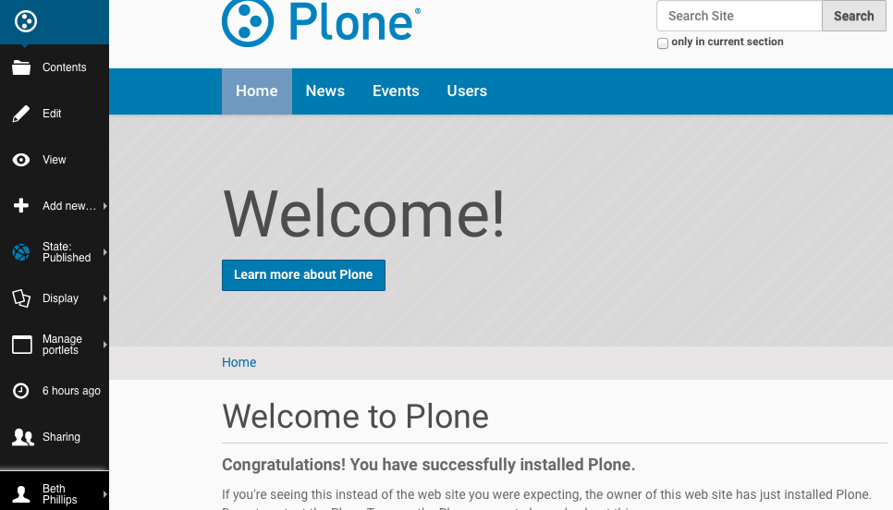
The New CMS Editor Bar

Slide 3
No More Green Bar
This new bar, running down the left side of the page, replaces the green bar from the previous version of the CMS. You must be logged in to see this bar. Your name will appear at the bottom of the bar.
It contains the same options you used with the green bar.
Next, we’ll explore Contents, Edit, View, Add new…, State:, and Display.

Slide 4
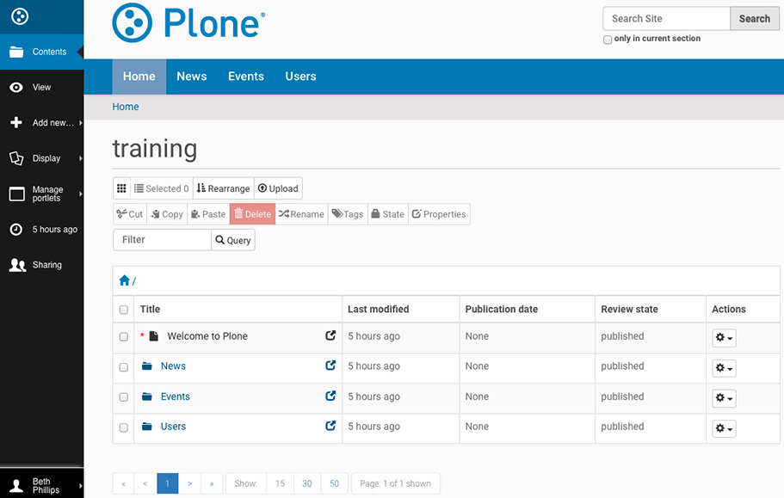
The Contents Area

Slide 5
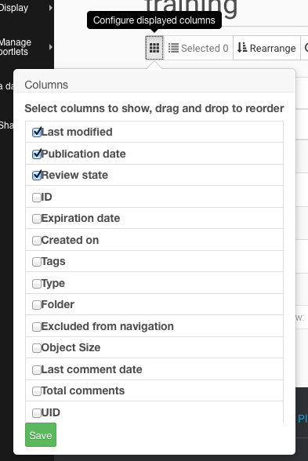
Column Configuration and Display
Columns Button
Column Options
This button allows you to choose additional columns to display in the contents table, like last modified, tags, and folder.

Slide 6
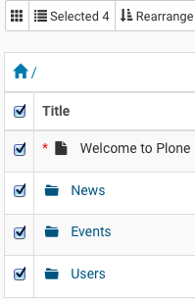
Selected Items
Selected Area
Selected View
This area shows you how many items are selected from the contents table.
A great use case would be when you intend to delete an item/items. Being able to easily see how many items are selected can help prevent unintentional deletions.

Slide 7
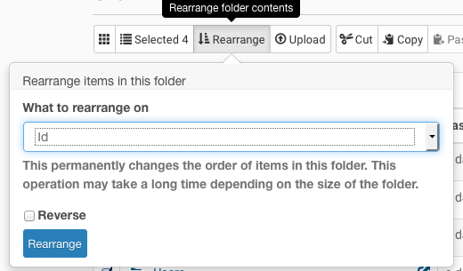
Rearrange Contents
Rearrange Button
Rearrange Form
This button allows items within a folder to be sorted.
Some sort options are alphabetical, by title, or chronological.
Caution: if a folder gets rearranged, it will change the order of the navigation links in your site, and changes are permanent.

Slide 8
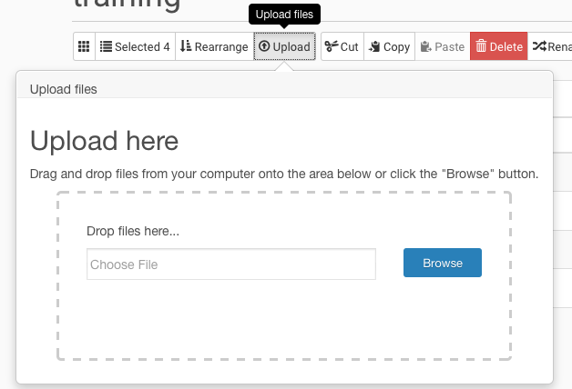
Upload Files
Upload Button
Upload Form
With this option, you are able to upload one or more files to the CMS.
To upload a file, you can either browse to where the file is stored, or you can drag & drop files from your computer to the dotted area in the upload form.

Slide 9
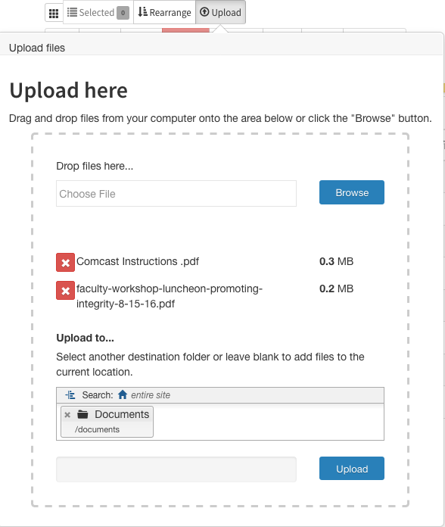
Upload Files: Upload Form
Upload Form
You can add one or more files, but keep in mind that you will still need to assign proper titles and summaries.
You can also choose the destination folder, but I’d recommend navigating to that folder first, and then uploading the file(s).

Slide 10
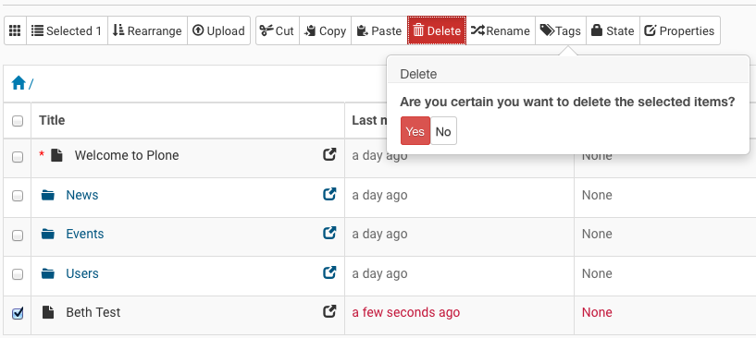
The (No Longer) Dreaded Delete
Now, you can easily see how many items have been selected and decide if you really want to follow through.

Slide 11
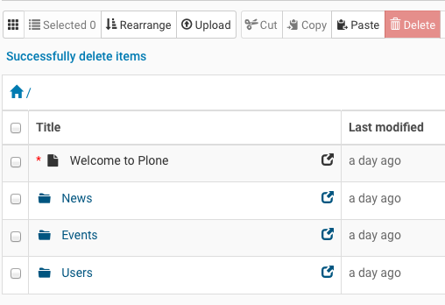
The (No Longer) Dreaded Delete: A Success Deletion
Once a delete is completed, Selected returns to zero, and you’re informed of your success.
Delete should still be used with caution.
If you accidentally delete something, please contact the Web team ASAP.

Slide 12
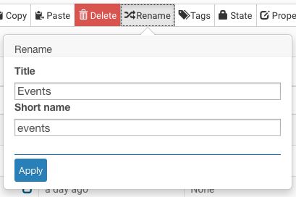
Rename Files
Rename Button
Rename Form
Rename works very much the same way as it always did.
As always, remember that changing the short name, or web address, could break links. Changing a short name should be a rare, if ever, occurrence.

Slide 13
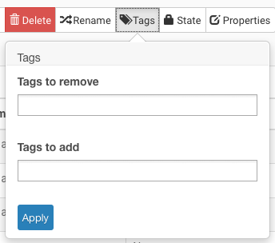
Tagging Files
Tag Button
Tag Form
This option allows you to set tags on several items at once.
You can also remove tags on several items at once.
Some editors never use tags. If you don’t currently use them, you don’t need to start.

Slide 14
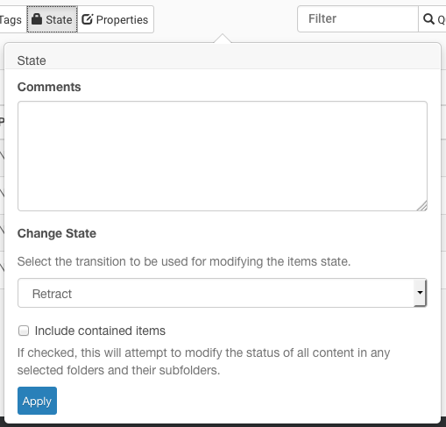
Changing States
State Button
State Form
The State button allows you to change the state of one or more items.
In our case, Comments aren’t necessary.
Under Change State, pick either Publish or Retract, and if you’re changing the state of an entire folder and want to publish/retract all items in the folder, choose to include contained items.

Slide 15
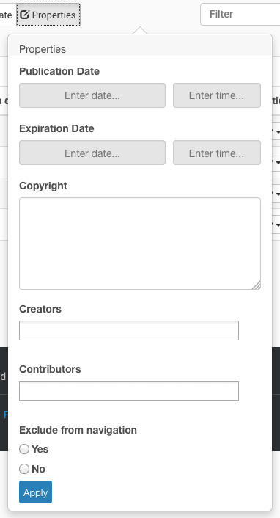
Properties
The only part of Properties that you’ll need to use is at the very bottom. Exclude from navigation should look familiar to you.

Slide 16
The Query Box
Use this to locate items in the contents area by using all/part of a title or any other identifier.

Slide 17
Breadcrumbs in Contents
Home Icon Link
Breadcrumbs
This helps you to understand where you are in the Contents hierarchy.
It’s important to know where you are so that content is created/moved to exactly where you intended.
Each item in the breadcrumbs indicates a folder.
You can easily determine that you are looking at the contents of the Events folder.
You navigate back through the hierarchy by clicking on a specific folder in the breadcrumbs.

Slide 18
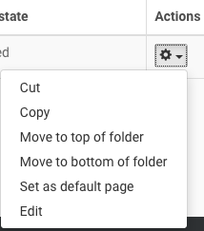
Actions
Actions
Actions Dropdown
This option works on single items in the contents.

Slide 19
Actions: Defined
Cut & Copy work the way you know them to.
Move to the top/bottom of folder will place the item at either the top or bottom of the Contents table.
Set as default page will make the item the landing page, or home page of the folder.
Edit will allow you to edit the item.

Slide 20
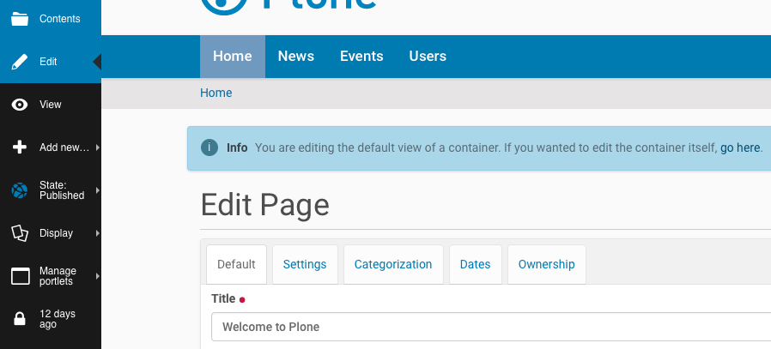
Editing a Page

Slide 21
Visual Text Editor Toolbar
Portions of the editor toolbar have changed dramatically. I’m going to cover the changes in this section.

Slide 22
The Insert Dropdown
The options in this dropdown are meant for Web team use only. Please don’t use them.

Slide 23
The Tools Dropdown
This option allows you to view HTML code. If you’re comfortable with this, you can use it, but the majority of editors prefer to use the visual editor.

Slide 24
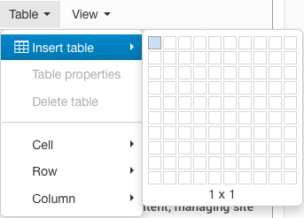
The Table Dropdown
This option allows you to add a table. This option contains the most changes for editors to learn to use.
First, choose the number of columns and rows for the table. This will add the table to the body content area and close the table dropdown.

Slide 25
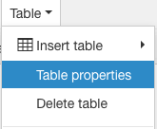
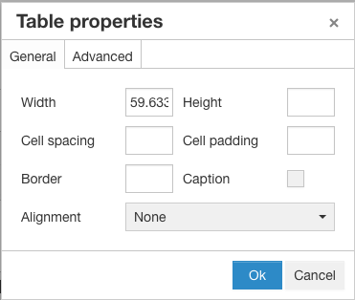
The Table Dropdown: Table Properties
Next, from the Table dropdown, choose Table properties.
The Table properties window will open, offering several options.

Slide 26
The Table Dropdown: Table Properties Caption
There is only one thing you need to do: Check the caption box.
You should NOT change the width, height, cell spacing or padding, border, or alignment. I’m working to see if I can remove these to make learning to use tables easier, but for now, the options are there.

Slide 27
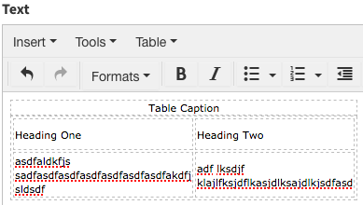
The Table Dropdown: Tabbing & Table Headings
In this editor, you’re able to tab through the cells. I recommend tabbing to go forward, and Shift+Tab-bing to go backwards.
Add content to the table, making sure to include the table caption as well as headings for each column.

Slide 28
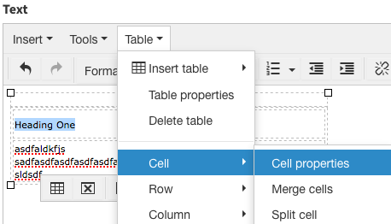
The Table Dropdown: Cell Properties
Next, highlight the first column heading.
Choose Table, and then Cell, and Cell properties.

Slide 29
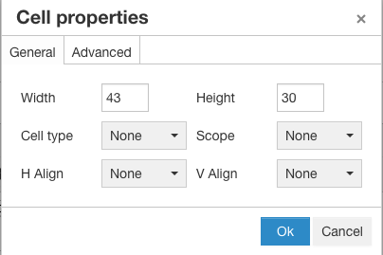
The Table Dropdown Cont.
In Cell properties, you’ll only need to set the Cell type and Scope. You should NOT change anything else in this area. This is another area where I’m trying to remove the additional options, but for now, they are there.

Slide 30
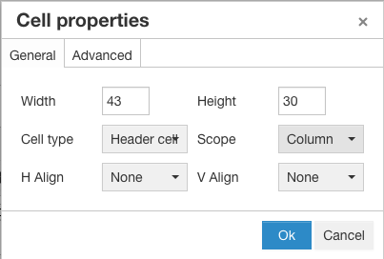
The Table Dropdown: Cell Type & Scope
Cell type should be set to Header cell, and Scope should be set to Column.
You’ll need to repeat this step for each column header. This is REQUIRED to meet accessibility standards.
When you create a new table, please let me know so I can check it.

Slide 31
Redo and Undo
Undo reverses the last action you performed, and Redo undoes the last Undo action.

Slide 32
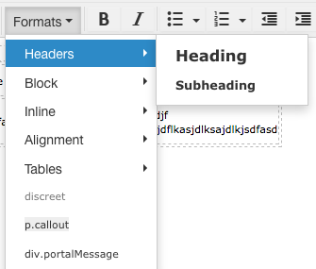
The Formats Dropdown
This area is equivalent to the Style selector dropdown box. Headers contains the Heading and Subheading styles.

Slide 33
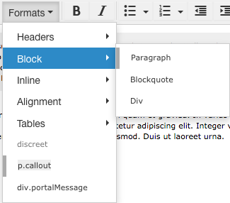
The Formats Dropdown Cont.
Block contains styles you’ll seldom use. When you add content, paragraph styles are automatically added. There may be an odd occurrence where you need to apply it.
Blockquote is used for quotes.
Div is used by the web team, and shouldn’t be used by editors.

Slide 34
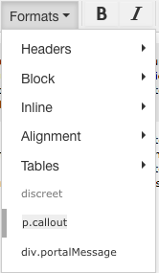
The Formats Dropdown: Additional Options
You’ll only need to use p.callout for call out boxes.
You can use Alignment to make text bold or italic, but since those options are already on the toolbar, it would make sense to use them instead.
Discreet is disabled.
Please don’t use div.portalMessage.
I’m hoping to be able to remove some of these options, but that’s still a work in progress.

Slide 35
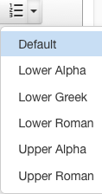
Bulleted/Numbered Lists
There are now several additional list style options available. It’s important to remember that professional, branded sites like ours should have a consistent look rather than using several styles to make content “stand out.”
Please only use Default unless you have nested lists.

Slide 36
Decrease & Increase Indent
These options should only be used for nested lists. They should NOT be used for aesthetics.

Slide 37
Removing A Link
This works just like before.

Slide 38
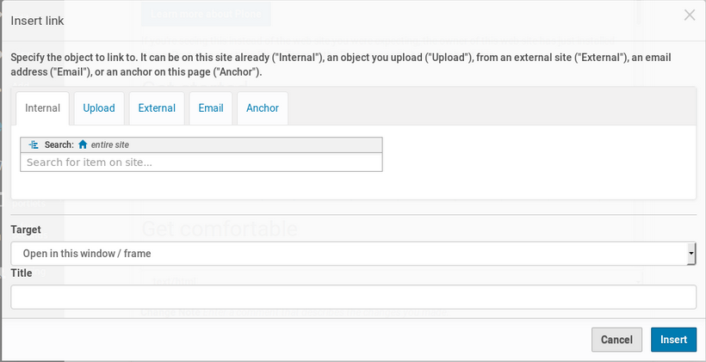
Inserting/Editing Links
Insert/Edit Link button
Internal Links

Slide 39
Inserting/Editing Links: Internal Links
Internal Links
The Internal link option allows you to search for, or navigate to, the content item that you want to link to within the current website.
For accessibility purposes, the "target” should open in the same browser window. Don’t choose for it to open in a new one.

Slide 40
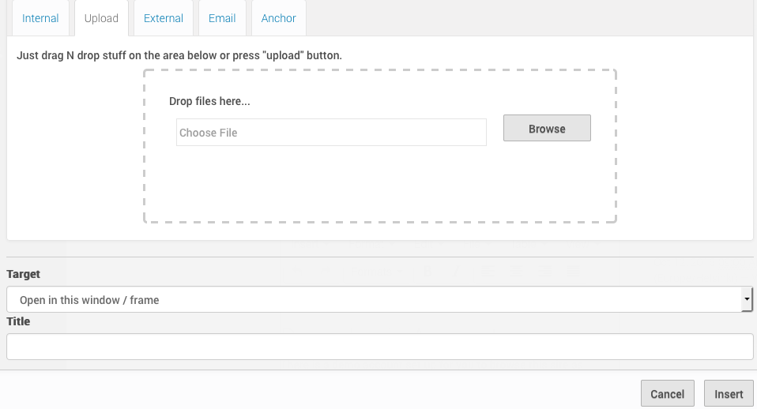
Inserting/Editing Links: Upload Files Form
Upload Files

Slide 41
Inserting/Editing Links: Upload Files
Upload Files
The Upload section lets you upload a PDF, Office document, or other file. The upload will be stored in the same folder as the content item you are editing.
If you are adding a file that normally would be stored in a Documents folder, this option won’t work, as the page, event, or news item isn’t stored in that folder. You’ll want to upload the file in the traditional manor.

Slide 42
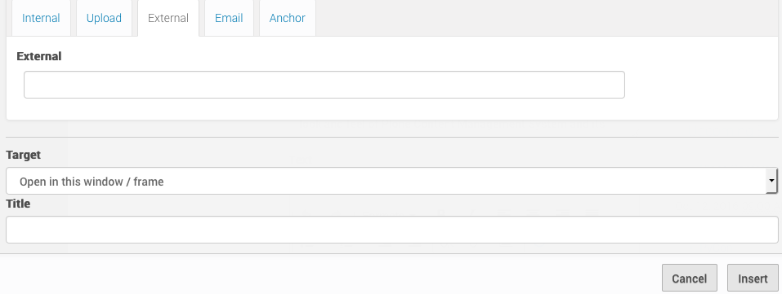
Inserting/Editing Links: External Links Form
External Links

Slide 43
Inserting/Editing Links: External Links
External Links
The External link option allows you to link to other website’s content. When linking to external sites, make sure you include the complete link, including the "http//" or "https://" part. For accessibility purposes, the "target” should open in the same browser window. Don’t choose for it to open in a new one.

Slide 44
Inserting/Editing Links: Email & Anchor
The Email option lets you create a mailto: link, which will open in the user's email program. You can optionally set a subject for the email, although your visitor will always be able to override it. So setting the Email Subject is more a helpful suggestion.
The Anchor link is not used.

Slide 45
Inserting/Editing Images
Don’t do it! This is for the Web team’s use. If you need images added, please submit a request through Service Now.

Slide 46
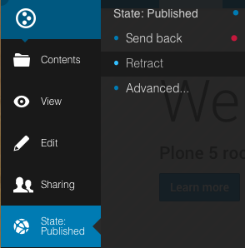
State
You can change the state of a page by choosing this from the side toolbar.
Published and Retract are the two options we use. Remember that files and images don’t have a state. They’re automatically available for viewing by the public.

Slide 47
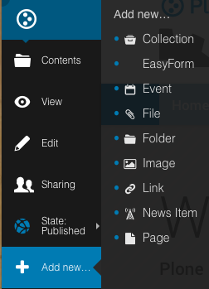
Add New
This should look very familiar to you. The most common content types you’ll pick are Event, File, Folder, and Page.

Slide 48
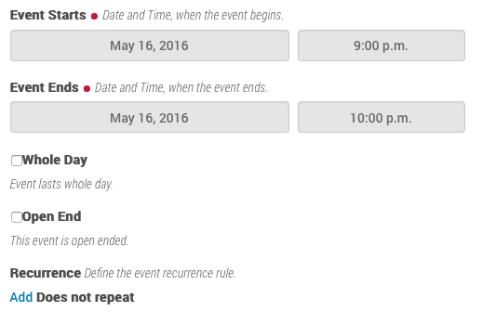
Add New Event
The Event content type also has several changes. If you don’t already add events, you won’t need to start.

Slide 49
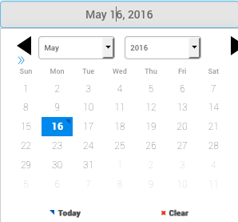
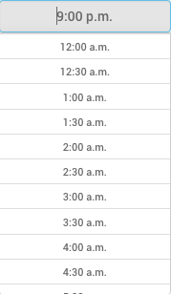
Add New Event: Start/End Dates
Event Start/End Dates
Time

Slide 50
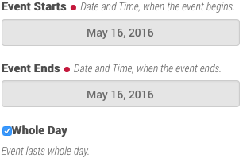
Add New Event: Whole Day
There are more options available in this new version of events that weren’t previously.

Slide 51
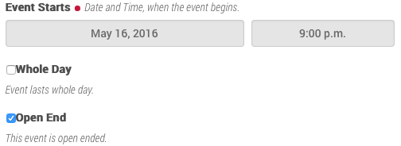
Add New Event: Open End

Slide 52
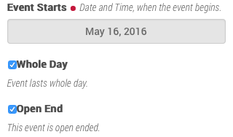
Add New Event: Whole Day & Open End Event

Slide 53
The Remediation that Never Ends
Recently, web accessibility issues with Penn State’s website were reported to the Office of Civil Liberties.
The OCL will be checking the PSU site, as well as others of its choosing, to see where there may be issues that need to be addressed.
What this means for us: continued diligence.
I want to take a few minutes to touch on the areas where editors have control.

Slide 54
The Remediation that Never Ends: Summary, Headings, & Tables
Summary – All pages and files need to have a summary, or description, that describes it. It’s not only helpful for better search results, but for those using screen reading software.
Headings – Remember that headings and subheadings should be used specifically for that. They shouldn’t be used because you just prefer the larger text. An entire paragraph should never be styled as either a heading or subheading.
Tables – As you now know, tables have more steps to create. If you create a new table or add new content, please let us know. That will help us make sure you understand the new process.
Also, remember that tables should only be used for tabular data, not for layout.

Slide 55
The Remediation that Never Ends: Links, Images, & Titling Files
Links – Be descriptive!! Avoid link text only containing words like “here” and “read more”.
Images – Please don’t add images. Instead, create a request in Service Now for the Web team. We’ll resize, optimize, and add them for you.
Titling Files – When uploading a PDF, DOCX, etc., be sure to properly title it by appending the file type to the end. IE: Beth’s Favorite Things PDF. Please take some time to go through your documents and fix any titles that are missing this.

Slide 56
The Remediation that Never Ends: PDF Files
PDF Files – This type of file is a sore spot in relation to accessibility. While we understand the importance of PDFs, they just aren’t accessible. What we need editors to do is use them as little as possible. If a PDF can be made into a web page/pages relatively easily, this is what should be done. Please take some time to go through your PDFs and see where they can be replaced by web pages.

Slide 57
Thank You!
RIIT Group Web Team
Kyle Hartzell
Beth Phillips
Chris Thomas
Email: web@smeal.psu.edu
Phone: 814-865-0366

